Slide 1



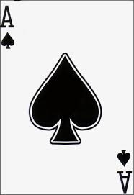

SOLITAIRE
2011510105 -Berkay Türkgeldi 2010510053 -Filiz Lüllecioğlu 2011510101 -Merve Şahan

Slide 2

CONTENTS
INTRODUCTION
PROGRESS SUMMARY
FLOWCHART OF SOLITARE GAME
PROBLEMS ENCOUNTERED AND SOLUTIONS
SCREENSHOTS
QUESTIONS

Slide 3


INTRODUCTION
The aim of the project is :
The aim of the project is to develop Solitaire game with one player.
General Information
The game is played with one deck of cards. The deck has 52 cards including Hearts, Diamonds, Spades and Clubs suits and each suit has A, 2, 3, 4, 5, 6, 7, 8, 9, 10, J, Q, K. The game is played on 7 piles.

Slide 4
PROGRESS SUMMARY
First Week : Designing classes, creating a deck and shuffling the deck.
Second Week : Reading high score table from the file, printing in increasing and decreasing order.
Fifth Week : Remaining part of the games, testing.
Third Week : Placing cards.
Move the cards.

Slide 5
FIRST WEEK
We designed object oriented model of the project.
We developed game screen.
for(int i=4;i<40;i+=2)
{
print(i,36,"_);
}
print(49, 0, "P1");
print(49+20, 0 , "P2");
print(49+(20*2), 0 , "P3");
print(49+(20*3), 0 , "P4");
print(49+(20*4), 0 , "P5");
print(49+(20*5), 0 , "P6");
print(49+(20*6), 0 , "P7");
if(suit.equals("heart"))
{
foregr = Color.RED;
symbol = "♥";
}
if(card.isOpen())
{
backgr = Color.WHITE;
}

Slide 6
SECOND WEEK
public class Deck
public class Player
public class PileNode
public class Stack
public class CircularLinkedList
public class SingleLinked
public CircularLinkedList(Object addHead)
{
CLLNode headNode = new CLLNode(addHead);
head = headNode;
head.setLink(head);
}
We created the necessary data structures and classes.
ReADING HIGH SCORE

Slide 7
THIRD WEEK
Placing cards.
Move the cards.
Stack stckHeart = new Stack(15);
Stack stckDiamond = new Stack(15);
Stack stckSpade = new Stack(15);
Stack stckClub = new Stack(15);
((Card)stockList.getHead().getData()).setOpen(false);
multi.cardDisplay(stckLeft, (Card)stockList.getHead().getData());
((Card)stockList.getHead().getData()).setOpen(true);
multi.cardDisplay(stock, (Card)stockList.getHead().getData());

Slide 8
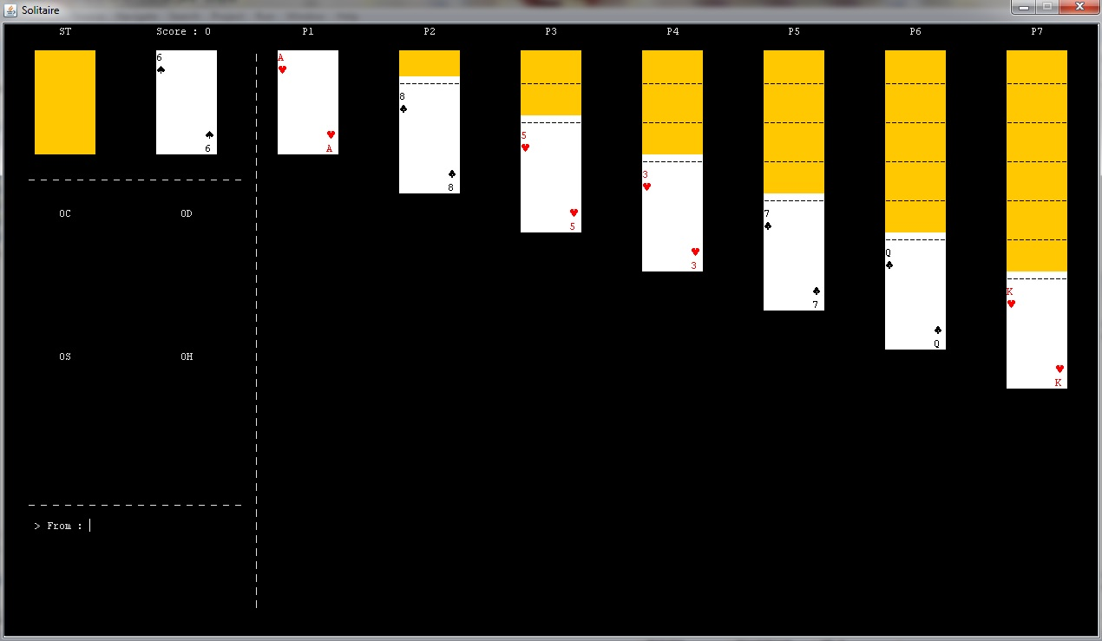
FOURTH WEEK
We tested the game.
We prepared presentation and website

Slide 9
PROBLEMS ENCOUNTERED AND SOLUTIONS
When moving cards, the cards «K» and «A» was problem in different parts
We control these conditions with if statements for every special case

Slide 10
PROBLEMS ENCOUNTERED AND SOLUTIONS
Problem
When using card comparisons,
we could not compare two cards in
some cases
Solution
We used integer and string variables
for different cases and in some part
of the code, we compare cards according to their values because of isOpen variable

Slide 11
PROBLEMS ENCOUNTERED AND SOLUTIONS
Problem
When taking from and to piles from user, if we get a card with a value of 10, an error was occured immediately
Solution
When taking cards from user, if the length of the start card is 3, we take last 2 char of the string, if the length is 2, we take last char of the string to create card, otherwise we do not do anything

Slide 12
SCREENSHOTS

Slide 13
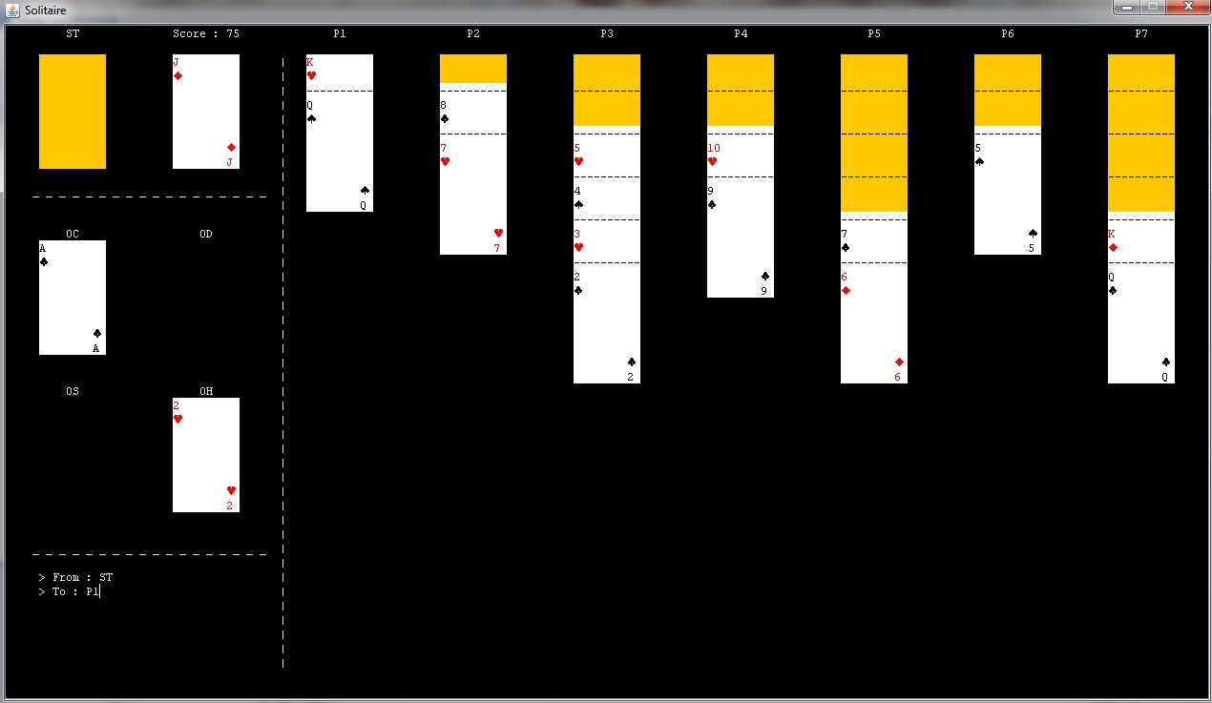
SCREENSHOTS

Slide 14
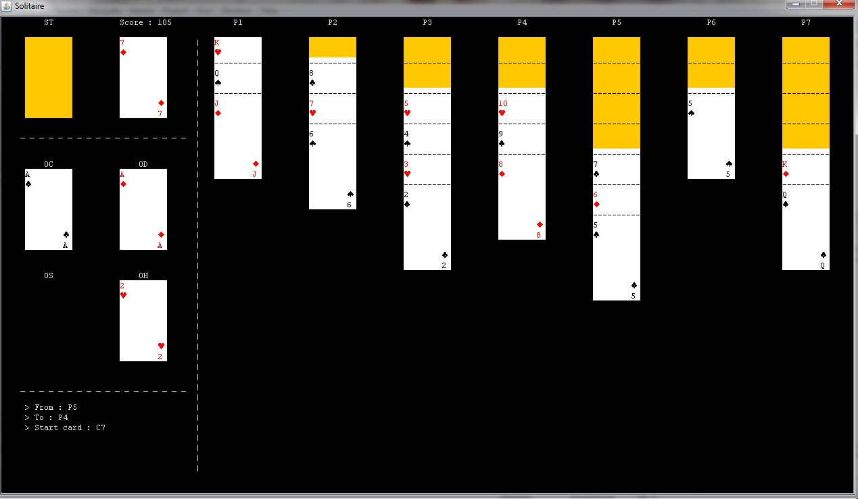
SCREENSHOTS

Slide 15
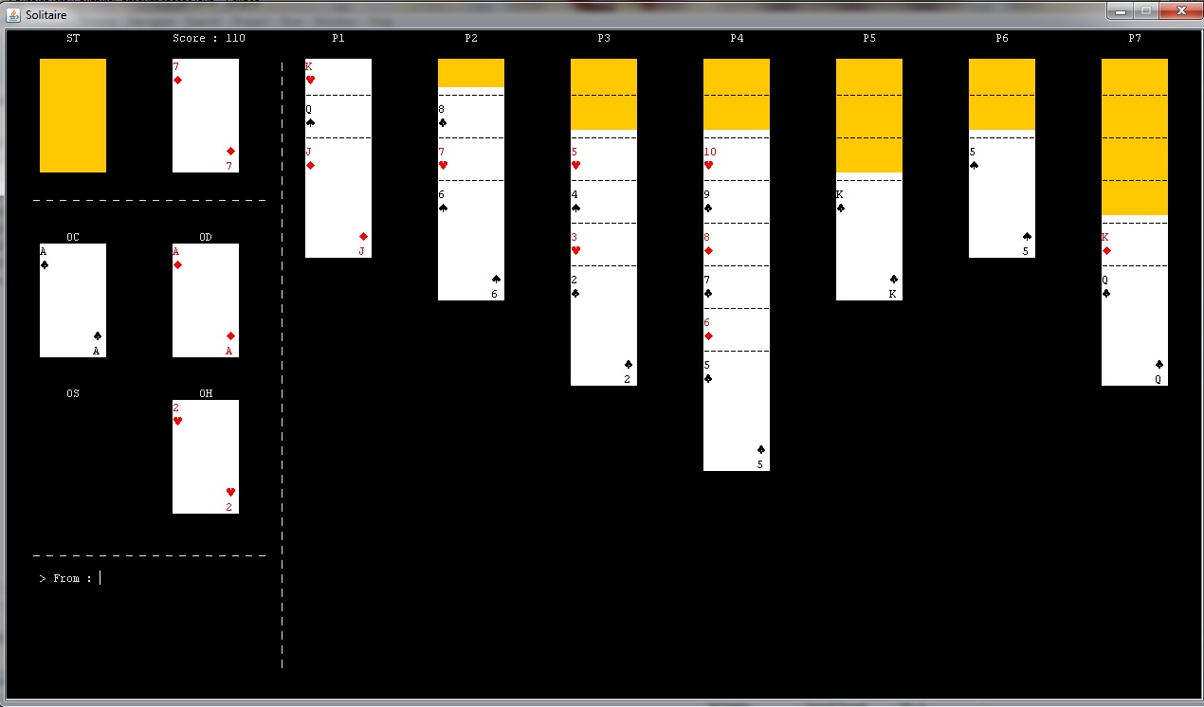
SCREENSHOTS

Slide 16
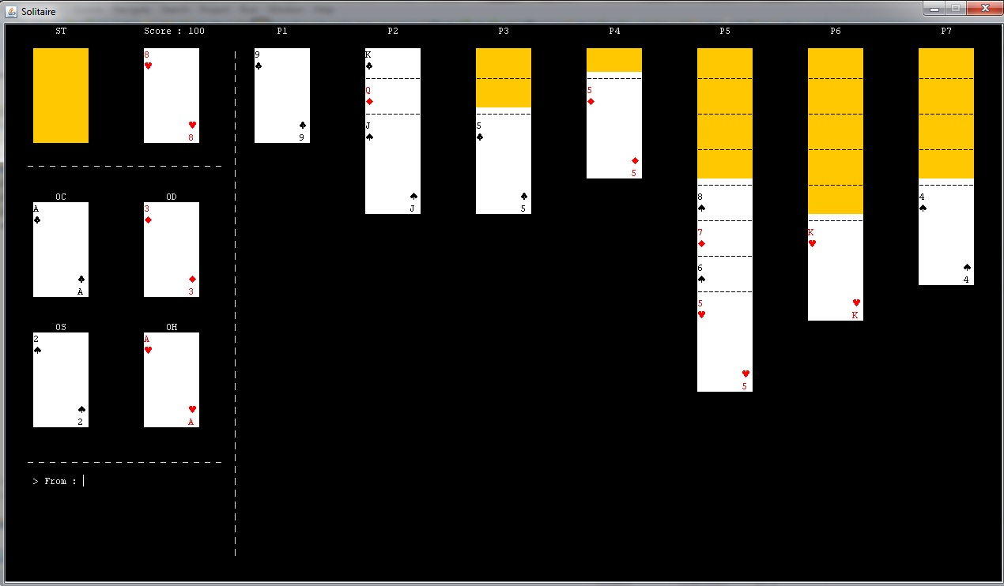
SCREENSHOTS

Slide 17
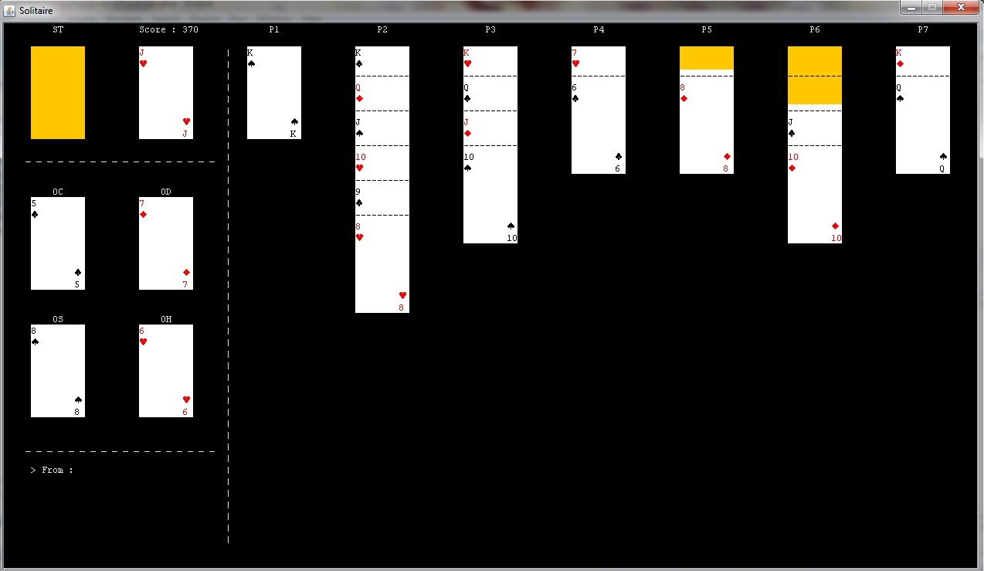
SCREENSHOTS

Slide 18
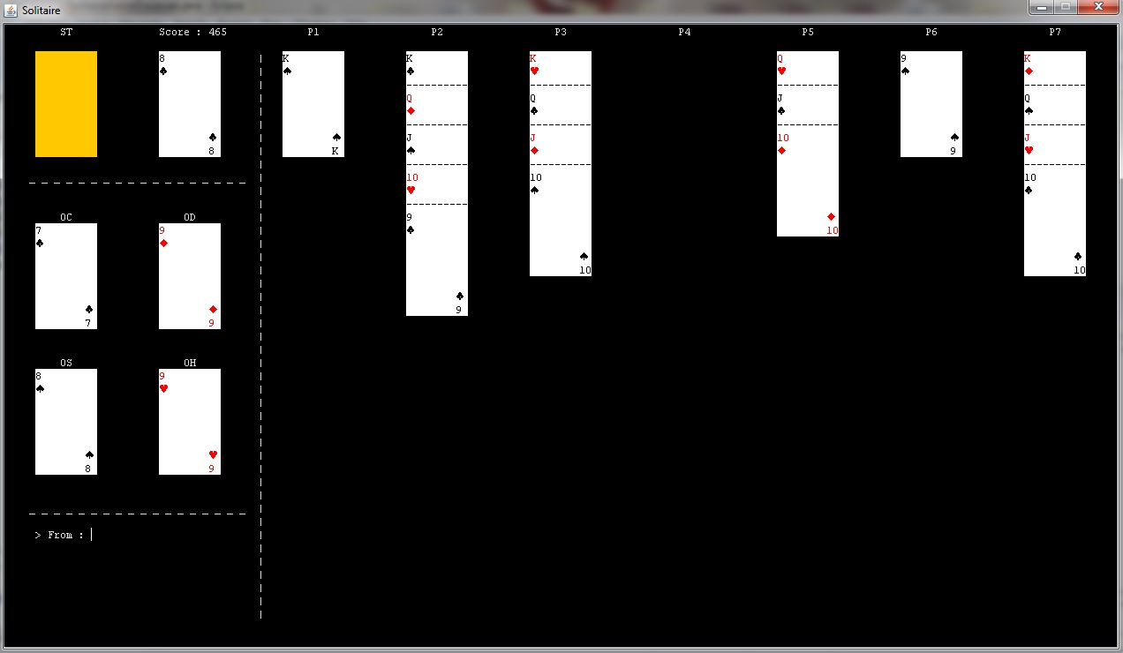
SCREENSHOTS

Slide 19
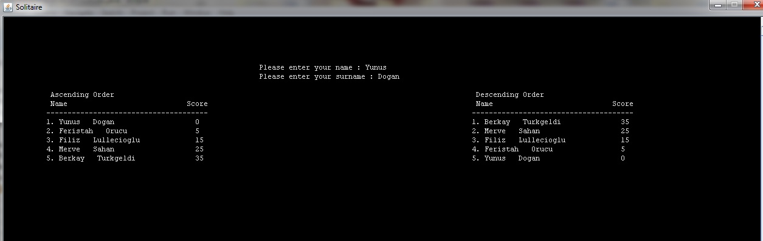
SCREENSHOTS

Slide 20


QUESTIONS

